Slide 1
Eric Price
Designer & Programmer

Slide 2
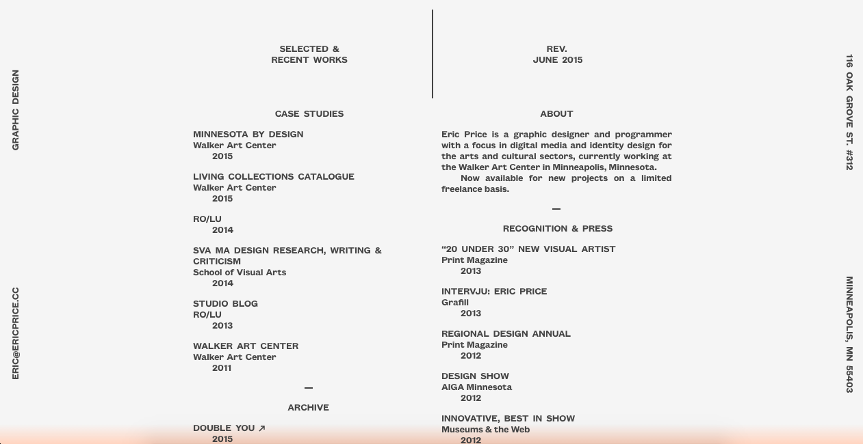

Slide 3
The Basics
Currently based in Minnesota
Working as a freelance designer/programmer and employed at The Walker Art Center, a contemporary art museum in Minneapolis
BS Graphic Design from the University of Minnesota
Named one of Print Magazine’s “20 Under 30” New Visual Artist in 2013
Has been recognized by AIGA Minnesota (2012), Museums and the Web (Innovative, Best in Show 2012), and Good Magazine (The Year In Design That Works, 2011)

Slide 4
Design Elements
Clean, simple and minimalistic
Intuitive
Innovative use of scroll (more often than not than to create layers)
Simple animations and images
Interactive

Slide 5
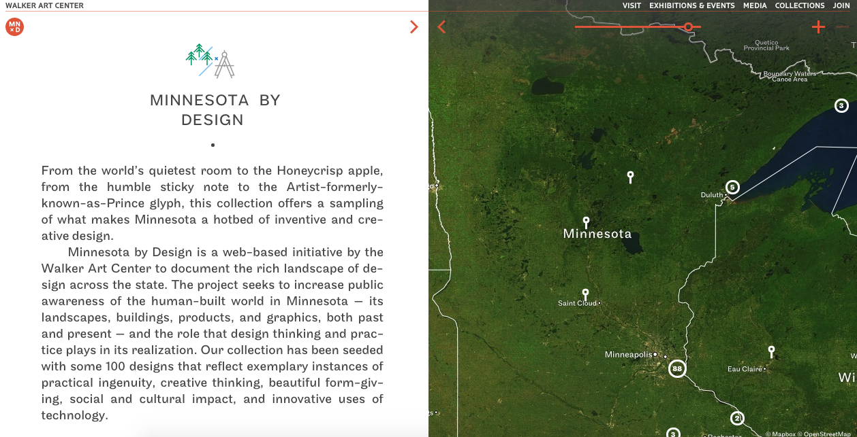

Slide 6
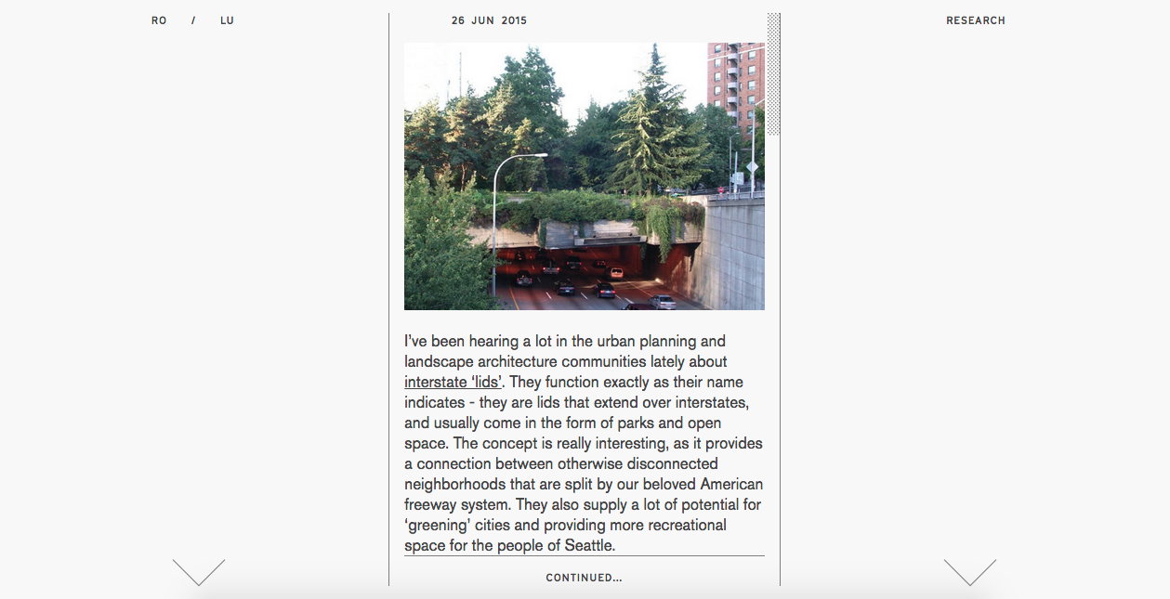

Slide 7
